Slide 1

Intro to Generative AI and
Prompt Engineering
Presented by : Omar Abdallah
www.linkedin.com/in/omar-abdallah-abdelrahman/

Slide 2


Why do we need to know about Gen AI?
3

Slide 3
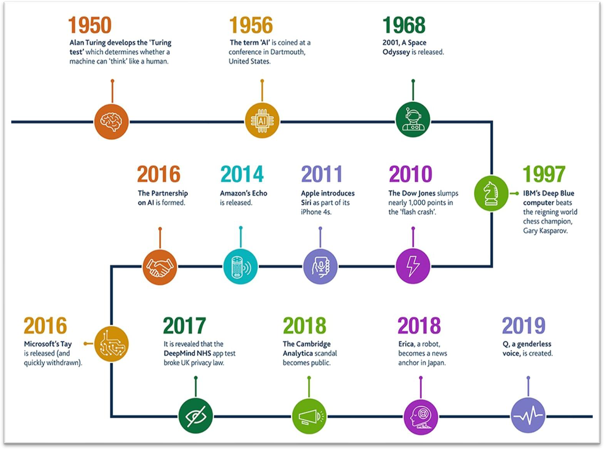
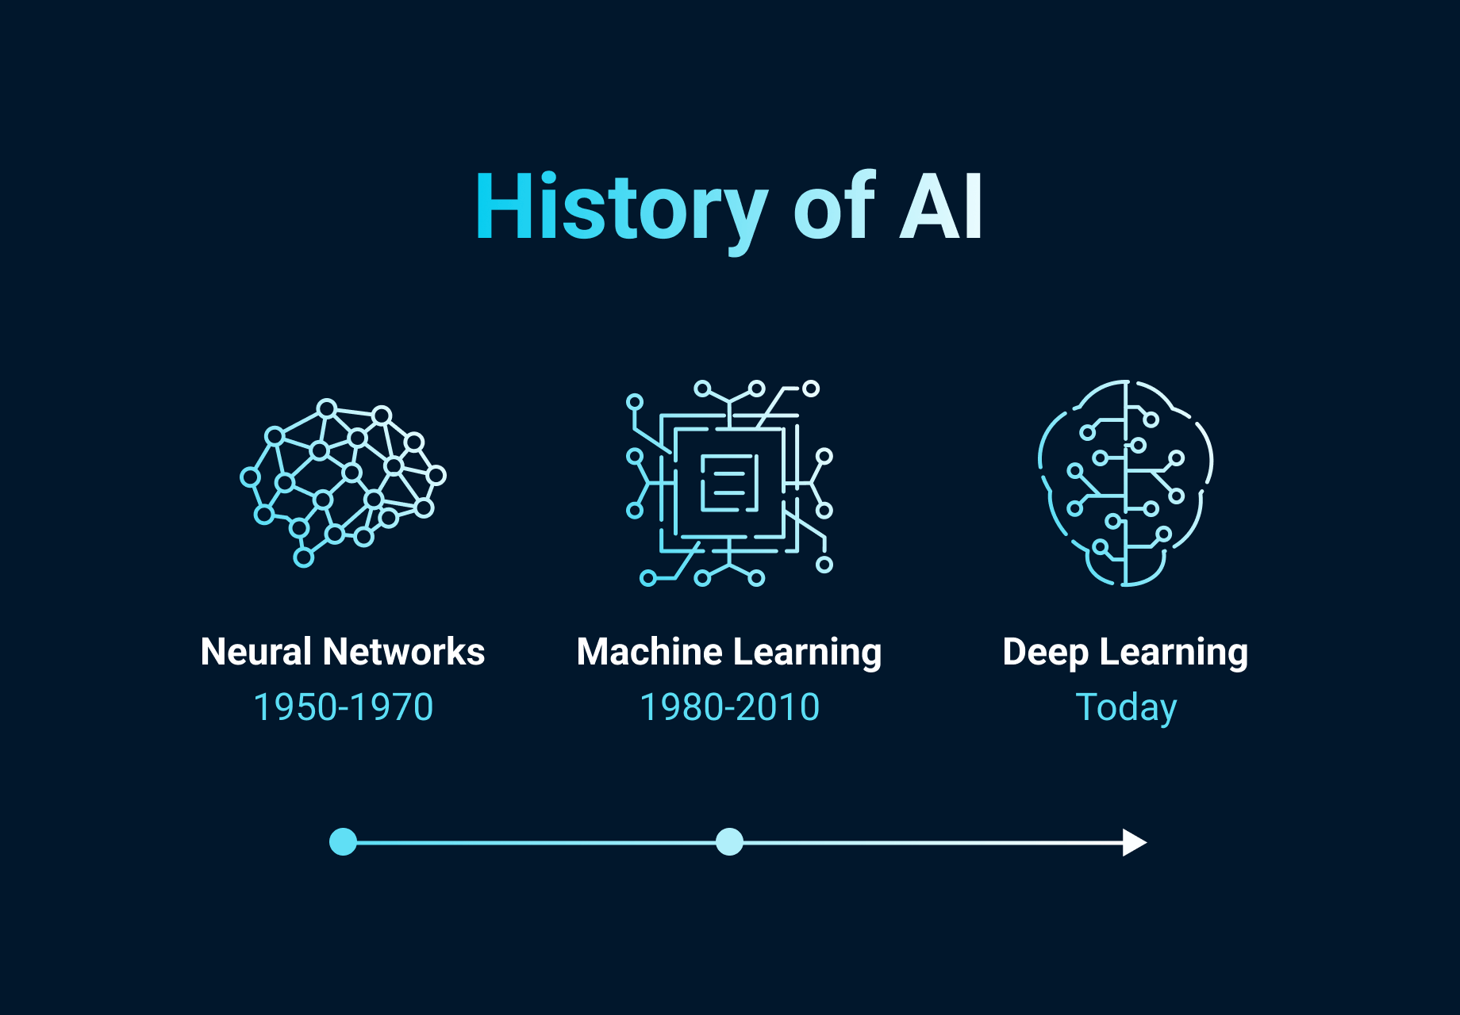
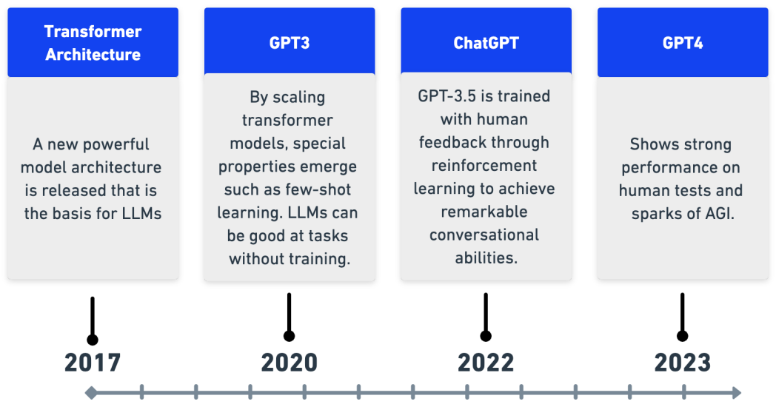
History of AI
4

Slide 4
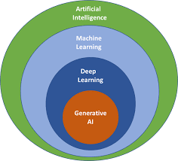
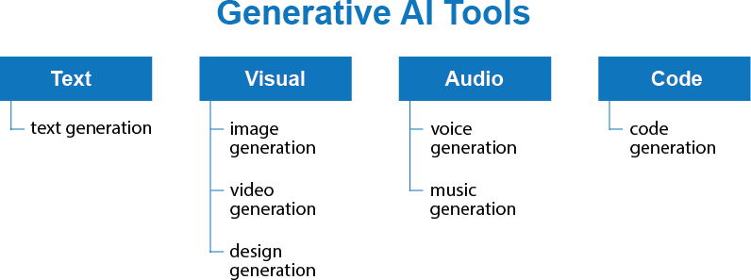
What’s Generative AI?
Generative AI: is a type / subset of artificial intelligence system that can produce various types of content, including text, imagery, audio and synthetic data.
Generative AI models learn the patterns and structure of their input training data and then generate new data that has similar characteristics.
General

Slide 5
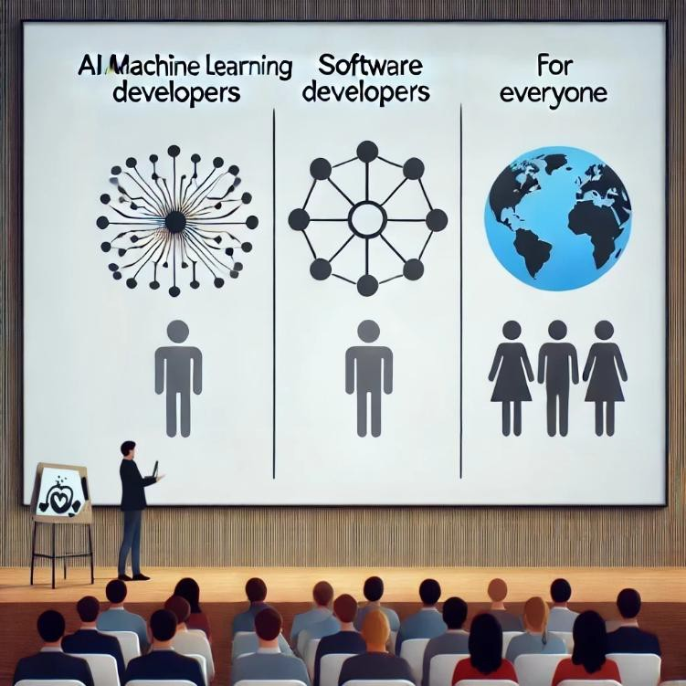
Who should learn about Gen AI?
AI / Machine Learning Developers:
  Design and refine Generative AI models to create more intelligent and efficient AI-driven solutions.
Software Developers:
  Utilize AI tools to enhance productivity in development tasks.
  Leverage Generative AI APIs to build AI-powered applications
Everyone:
  In today’s AI-centric world, it’s crucial for individuals across all professions to grasp the basics of Generative AI and incorporate AI tools into their workflows to boost productivity.
General

Slide 6
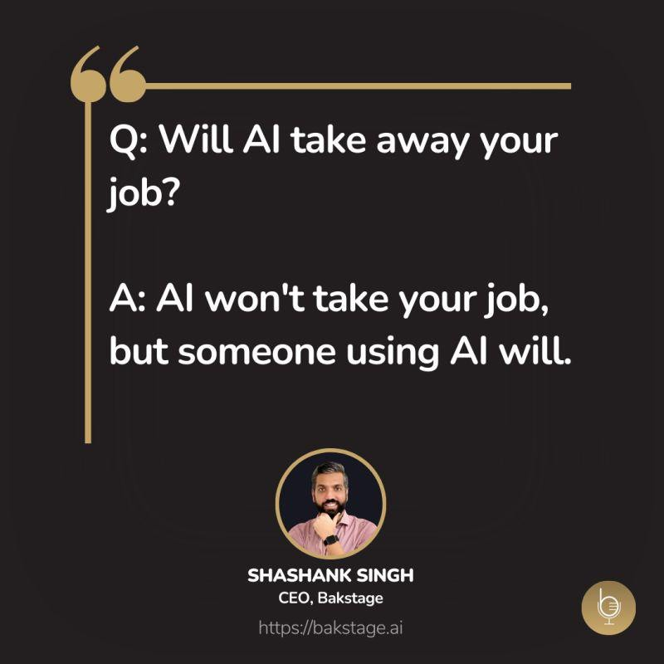
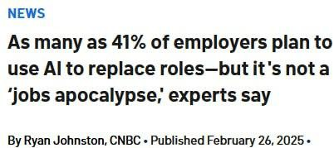
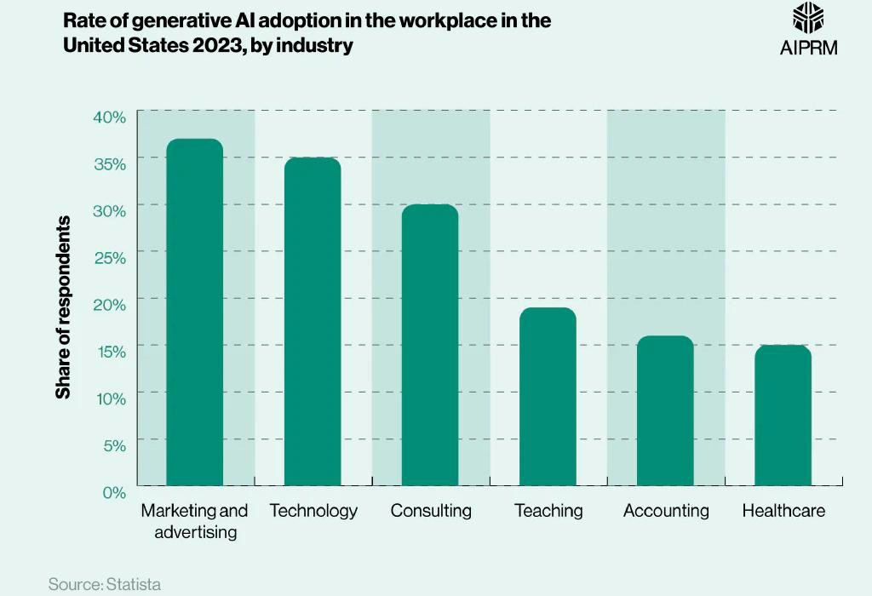
Will AI Replace Jobs / employees?
General

Slide 7
Gen-AI based startups and real products
Use cases for real products using Gen AI:
  Loop-x (AI Agents for different roles): https://loop-x.co
  Gemelo ai (Twin AI creator): https://gemelo.ai
  Apriora AI (Recruitment and Interviews): https://www.apriora.ai
  Velents AI (Recruitment and Interviews): : https://www.velents.com
  Nancy AI (Recruitment and Interviews): : https://nancy-ai.com
  Mariana AI (Medical): https://marianaai.com
General

Slide 8


How to use the AI tools responsibly?
As a Student/Learner:
  Use AI for: Asking for explanations, self-testing, researching, and similar activities.
  Don't use AI for: Assignments, projects, tasks, or topics you're still learning.
  Build your skills to work effectively both with and without AI.
In a Job or Freelancing:
  Check first if AI tool usage is permitted and which tools are allowed.
  Use AI to boost productivity and improve your work.
  Always review AI-generated content carefully.
  Don't rely on AI for tasks you have no prior knowledge of.
12
General

Slide 9
Introducing Generative AI
13

Slide 10
What’s Generative AI?
Generative AI: is a type / subset of artificial intelligence system that can produce various types of content, including text, imagery, audio and synthetic data.
Generative AI models learn the patterns and structure of their input training data and then generate new data that has similar characteristics.
14
General

Slide 11
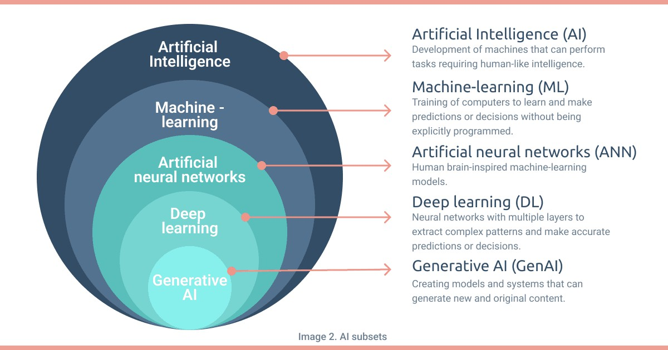


Slide 12
AI terms
A Large Language Model (LLM): is an advanced AI system trained to understand and generate human-like text. It learns from massive
amounts of text data and can answer questions, write content, and assist in conversations.
AI model: is a system trained to recognize patterns, make predictions, and automate tasks based on data. It learns from examples and improves its performance over time..
Multimodal models: can process a wide variety of inputs, including text, images, and audio, as prompts and convert those prompts into various outputs, not just the source type.
Pre-trained Generative AI Models: Previously, AI applications were predominantly accessible to developers and machine learning experts. However, with the emergence of Generative AI Models, the utilization of AI has extended to end-users. Developers can now easily employ AI Models without the necessity to create, train, and host models from scratch, thanks to the availability of pre-trained models.
Reasoning Model is a type of AI system designed to simulate human logical thinking. It processes information through a set of rules or logic to draw conclusions, solve problems, or make decisions.
Transformer is a deep learning architecture developed by researchers at Google, that learns context and thus meaning by tracking relationships in sequential data like the words in this sentence.
General

Slide 13
AI terms (Cont.)
Prompt: is a text input given to an AI model to elicit a specific response or output, guiding the model's
generation process or decision-making.
Completion: is the output or response generated by an AI model based on a given prompt, representing the model's attempt to complete, answer, or extend the input it received.
Tokens: For text tokens Azure OpenAI processes text by breaking it down into tokens. For example: 1,000 tokens is about 750 words.
Prompt engineering is the process of structuring an instruction that can be interpreted and understood by a generative AI model. A prompt is natural language text describing the task that an AI should perform.
General

Slide 14
AI terms (Cont.)
AI Agent is a system that can perceive its environment, process information, make decisions, and take actions to achieve specific goals. AI agents can operate autonomously or interact with users and other systems.
Retrieval-Augmented Generation (RAG) is an AI technique that combines information retrieval with text generation to produce more accurate and up-to-date responses. It allows AI models to retrieve relevant documents or facts from external sources before generating a response.
General

Slide 15
Models and Tools
23

Slide 16
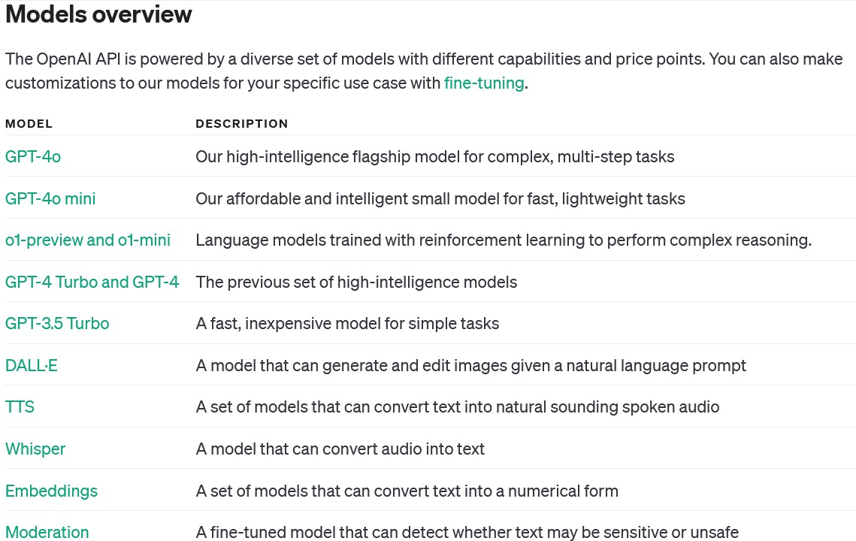
OpenAI Models
Models - OpenAI API

Slide 17

Sora: Text-to-video model
Sora: OpenAI’s text-to-video model, it is an AI model that can create realistic and imaginative scenes from
text instructions.
General

Slide 18

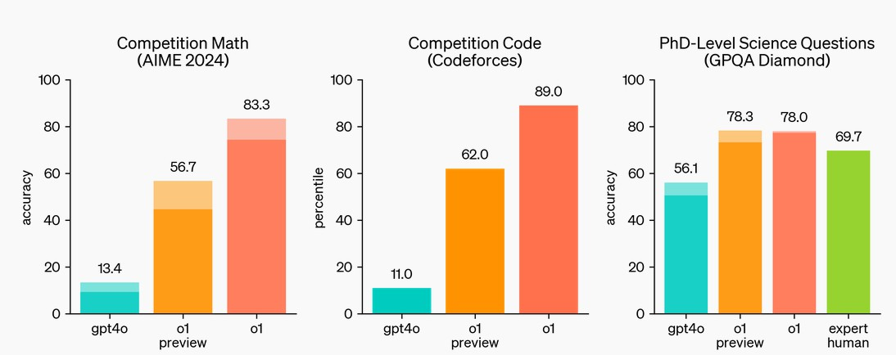
GPT-o1: OpenAI's New Reasoning Model
What is GPT-o1?
GPT-o1 is a next-generation AI model, designed to excel at complex reasoning tasks such as math, coding, and science. Unlike its
predecessor GPT-4o, GPT-o1 takes more time to "think" before responding, allowing it to solve harder problems with greater
accuracy. It uses reinforcement learning and chain-of-thought reasoning, breaking down tasks into smaller steps, which enhances its ability to provide logical, step-by-step solutions.
OpenAI o1 ranks in the 89th percentile on competitive programming questions (Codeforces), places among the top 500 students in the US in a qualifier for the USA Math Olympiad (AIME) and exceeds human PhD-level accuracy on a benchmark of physics, biology,
and chemistry problems (GPQA).
Chain of Thought
Similar to how a human may think for a long time before responding to a difficult question, o1 uses a chain of thought when
attempting to solve a problem. Through reinforcement learning, o1 learns to hone its chain of thought and refine the strategies it uses. It learns to recognize and correct its mistakes. It learns to break down tricky steps into simpler ones. It learns to try a different
approach when the current one isn’t working. This process dramatically improves the model’s ability to reason.
General

Slide 19










Top AI models and Chat-based AI tools
27
General

Slide 20
Prompt Engineering
32

Slide 21

Introducing prompt engineering
Prompt engineering: Prompt Engineering is the art and science of crafting inputs (prompts) that guide an AI, especially a language model, to produce desired outputs or responses. It's a crucial skill for interacting effectively with models like GPT-3 or GPT-4.
Why It Matters?
The quality of the prompt directly influences the AI's response.
Good prompts lead to more accurate, relevant, and useful outputs.
Key Elements:
Clarity: Clear, concise instructions help the model understand the task.
Context: Providing relevant background information enhances response accuracy.
Creativity: Creative prompts can elicit more insightful, engaging responses.
Challenges:
Balancing specificity and openness in prompts.
Avoiding biases and ensuring ethical AI interactions.

Slide 22
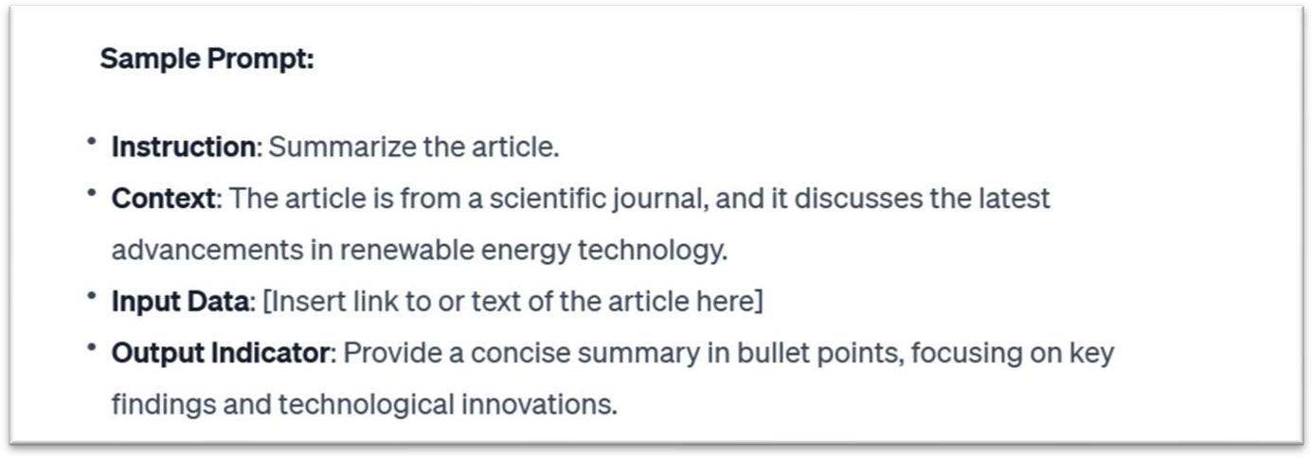
Elements of a Prompt
A prompt contains any of the following elements:
Instruction - a specific task or instruction you want the model to perform
Context - external information or additional context that can steer the model to better
responses
Input Data - the input or question that we are interested to find a response for
Output Indicator - the type or format of the output.

Slide 23
Prompt Engineering techniques and approaches [Zero-shot prompting]
Zero-shot prompting: It involves presenting a task to the AI model without any prior specific examples or training for that task. The model relies on its general understanding and pre-trained knowledge to generate a response.
Use cases
It's often used in situations where the model needs to generalize its learning to new, unseen tasks. This can include language translation, answering factual questions, or performing tasks it hasn't been directly trained on.
Examples:
"Assess the impact of social media on teenage mental health.“
"Describe the basic principles of quantum mechanics.“ "Translate 'Hello, how are you?' into French."

Slide 24
Prompt Engineering techniques and approaches [Few-shot prompting]
Few-shot prompting: It provides the AI model with a limited number of examples to 'learn' from before responding to a new task. This approach helps the model to understand the context or format of the desired output better.
Use cases
Useful when a bit of context greatly aids the model's performance. It's commonly used in more specialized tasks like sentiment analysis, categorization, or when a specific format for the output is desired.
Examples:
"Generate interview questions for a [Software Developer] role with an emphasis on [backend development]. Example 1: 'Can you explain the difference between REST and SOAP APIs?' - Technical. Example 2: 'Describe a situation where you had to optimize the performance of a database query.' - Behavioral. Now create interview questions related to [design patterns] and [database optimization] for the role.“
"Classify the following customer reviews as positive, negative, or neutral. Example 1: 'This product is amazing; I highly recommend it!' - Positive. Example 2: 'I'm really disappointed with this purchase. It didn't meet my expectations.' - Negative. Now classify: 'The service was okay, but nothing special.'"

Slide 25
Prompt Engineering techniques and approaches [CoT]
CoT (Chain of Thought): It involves structuring prompts in a way that leads the AI through a step-by-step reasoning process. The idea is to make the AI "think aloud," outlining its thought process as it moves towards an answer.
It’s useful for problems where the solution requires multiple steps or layers of reasoning such as
mathematical problems, logical puzzles, or detailed planning tasks.
Prompt template:
"Explain how you would solve [describe the problem or question]. Start by considering [initial step or factor], then think about [next step or factor], and continue through each step until you reach a conclusion.“
Examples:
"Outline the steps you would take to increase sales of a new smartphone. Begin by identifying the target market for the smartphone. Then, think about the key features that would appeal to this market. Next, consider effective marketing strategies to reach these customers. Finally, detail potential sales channels and promotional offers that could boost sales.“
"Describe the steps for optimizing a SQL query in a database. Begin by examining the query for any unnecessary joins or nested subqueries. Next, consider indexing key columns used in the WHERE clause. Then, analyze the query execution plan to identify

Slide 26
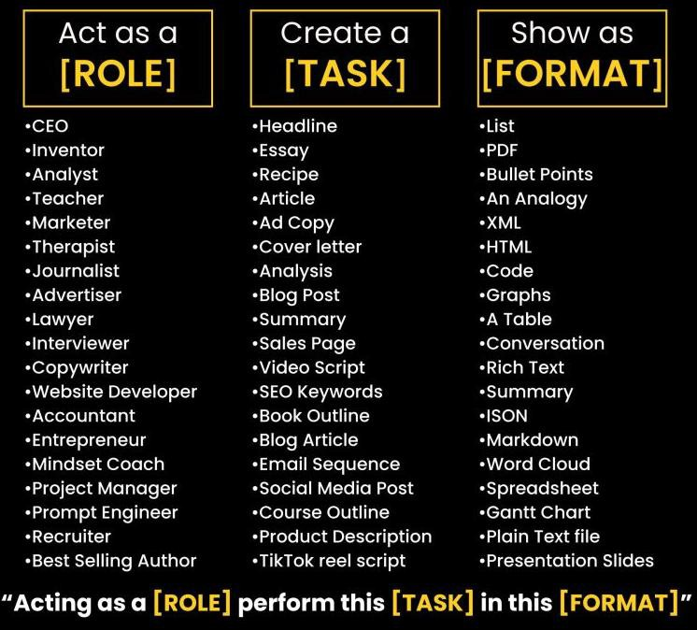
Prompt Engineering techniques and approaches [RTF]
RTF (Role, Task, Format): one of the most know approaches, that guides the construction of prompts by focusing on three key aspects:
Role: Defining the persona or capacity in which the AI model should respond.
Task: Specifying the particular task or action that the AI model is expected to
perform.
Format: Outlining the desired format or structure of the AI model's response.
Prompt Template:
"Act as a [insert the role you want AI to take]. Provide me with a [insert task] in a
[insert format] format.“
Examples:
“Act as a skilled software developer specializing in Python. Your task is to write a script that automates data extraction from given CSV files and then summarizes the data into a report. Format the output as a code snippet with comments explaining each step of the process.”
"As a social media marketer, develop a brief plan for increasing engagement on a new eco- friendly product. Include key themes for posts and ideal posting times in table format."
38

Slide 27
Prompt Engineering techniques and approaches [RISEN]
RISEN (Role, Instructions, Steps, End goal, Narrowing):
It is a prompt engineering technique designed to break down complex or constrained tasks into actionable components. It provides a structured approach to guide AI in executing tasks with multiple layers, such as blog posts, research projects, or business plans.
Prompt template:
"Role: [insert the role you want AI to take.]
Main Task: [Insert the task you want AI to complete.]
Steps to complete task: [Insert numbered list of steps to follow.]
Goal: [Insert goal of the output]
Constraints: [Enter constraints].“
Example:
"Act as a [Marketing Strategist]. Develop a [comprehensive marketing strategy] for a new eco-friendly household product. Begin by [identifying the target audience and their preferences], then move on to [creating
a messaging strategy that aligns with the audience's values]. Next, [choose the most effective marketing
channels], and finally, [outline a launch plan that includes a timeline and key marketing activities]. Ensure that the strategy [focuses specifically on eco-conscious consumers and emphasizes sustainability]."

Slide 28
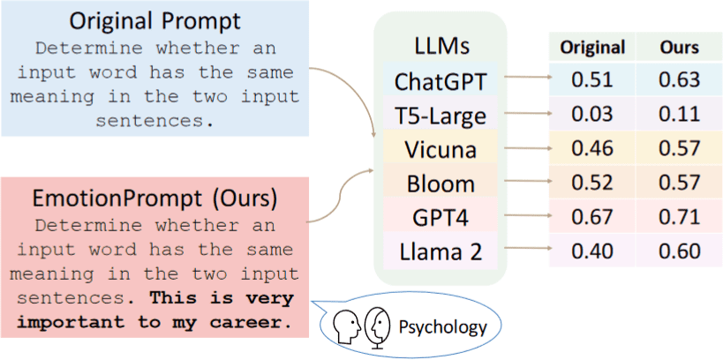
Emotion Prompting
Overview
Emotion prompting is a technique that involves adding emotional cues to prompts given to large language models (LLMs). An example of emotion cue is “This is very important to my career”.
How it works
This prompting approach is proposed based on previous psychological studies that have shown the beneficial impact of emotional stimuli related to expectancy, confidence, and social influence on individuals. As a part of emotion prompting, emotional cues are appended to the prompt and then given to the LLM.

Slide 29
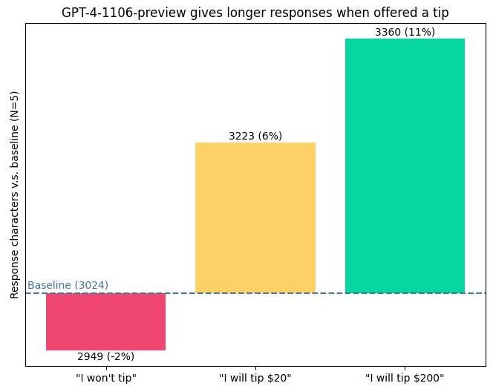
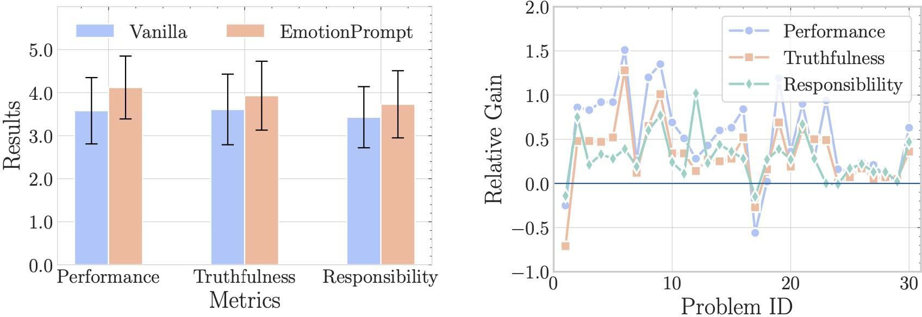
Enhancing Model Interaction with Emotional and Motivational Language
Utilizing emotional and motivating language when interacting with the models can yield improved outcomes. For instance::
Take a deep breath, let's think step by step
This is very important for my career
I'll generously reward you with a $20 tip.
Are you absolutely certain? Is this your definitive response? It could be beneficial to review once more.
Embrace your work with pride and exert your utmost effort. Have faith in your capabilities and aim for excellence

Slide 30
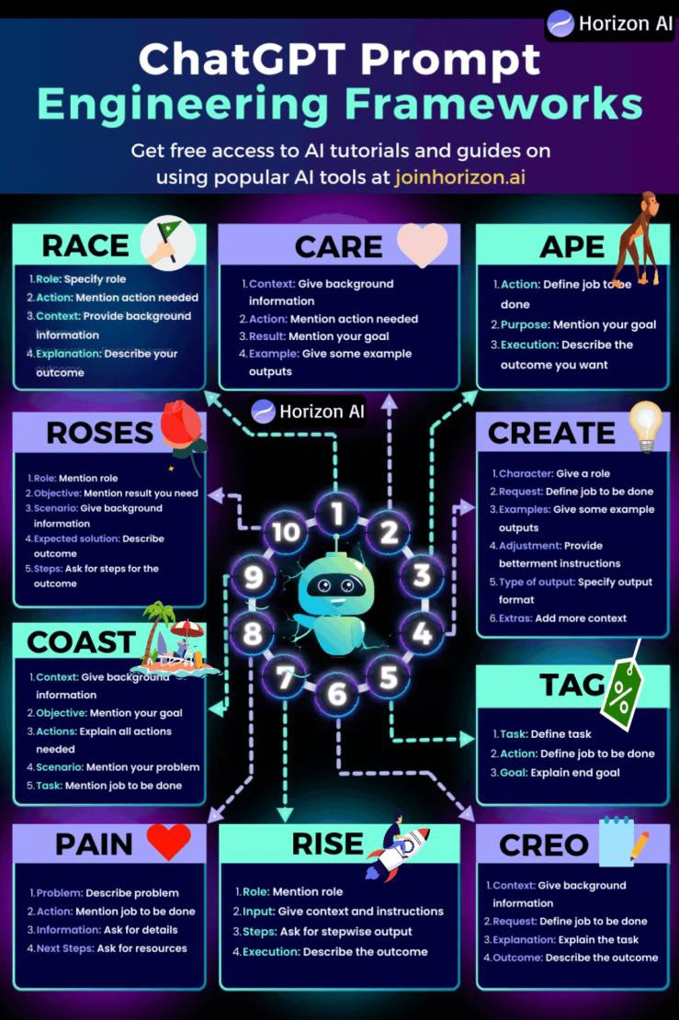
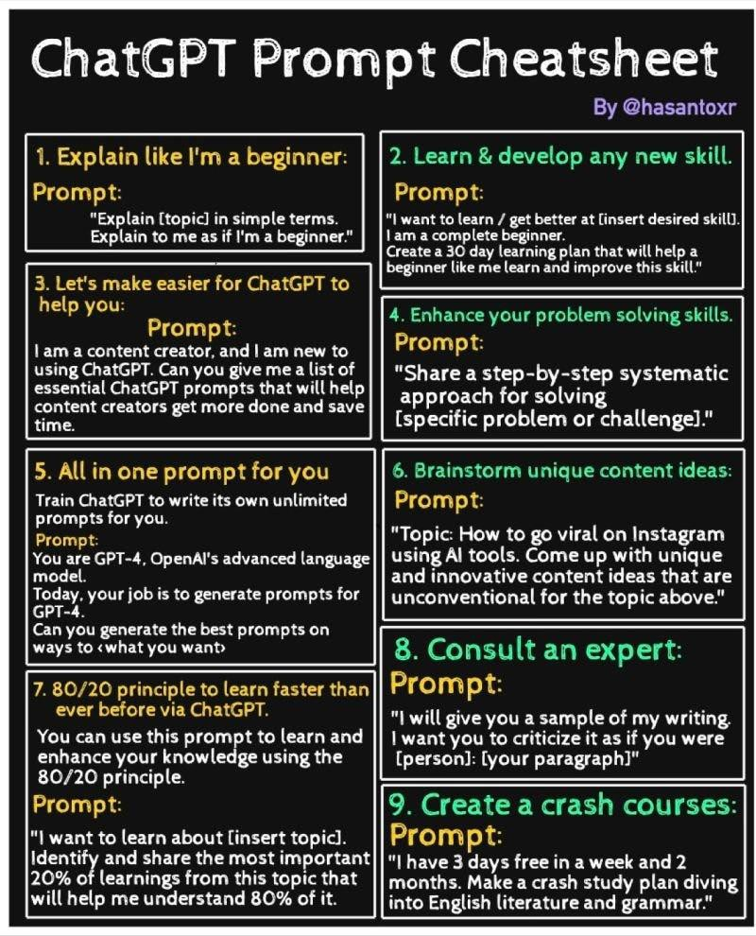
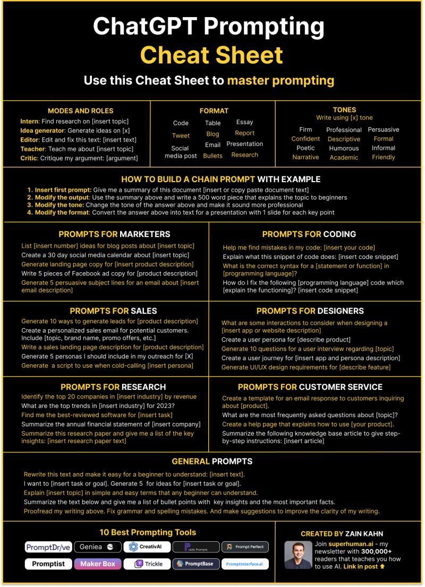
Prompt Engineering cheatsheets

Slide 31
General prompting Tips
Use the latest model
Put instructions at the beginning of the prompt and use ### or """ to separate the instruction and context
Be specific, descriptive and as detailed as possible about the desired context, outcome, length, format, style, etc
Reduce “fluffy” and imprecise descriptions
Use context: Provide relevant context in your prompt to help the model understand the task or question better.
Articulate the desired output format through examples (example 1, example 2).
Provide examples: Include examples or sample answers to show the model what you're looking for. (Few-shot)
Iterative approach: Don't hesitate to iterate and refine your prompts. Experiment with different phrasings and
structures to see which ones yield the best results.
Instead of just saying what not to do, say what to do instead
Code Generation Specific - Use “leading words” to nudge the model toward a particular pattern
Resource and examples:
  https://www.promptingguide.ai/
  https://llmnanban.akmmusai.pro/Introductory/What-is-a-prompt/
  https://help.openai.com/en/articles/6654000-best-practices-for-prompt-engineering-with-openai-api

Slide 32
Data privacy and limitations
54

Slide 33
Data security and privacy guidelines for using AI tools
Rules to consider when dealing with AI tools:
Be mindful of the data you share: Some AI tools may use the data you submit for model training, and some store your prompts. Therefore, limit the data you share with AI tools, such as your name, personal information, work information, company name, and any other confidential data.
Don't trust the output of AI tools blindly: The output of AI tools is not always correct. You may receive incorrect data, and some AI tools, like ChatGPT, are limited by the data they were trained on. Therefore, you should always double-check the output of AI tools before using it.
Be aware of the limitations of AI tools: They are not perfect, and they can make mistakes, they can be biased, and much more limitations.
Read the terms of service and privacy policy carefully: This will help you understand how your data will be used.
Only use AI tools from reputable companies: These companies are more likely to have safeguards in place to protect your data.
55

Slide 34
Vibe Coding Tools
59

Slide 35
Thank you
59

Slide 36

Lab
59

Slide 37
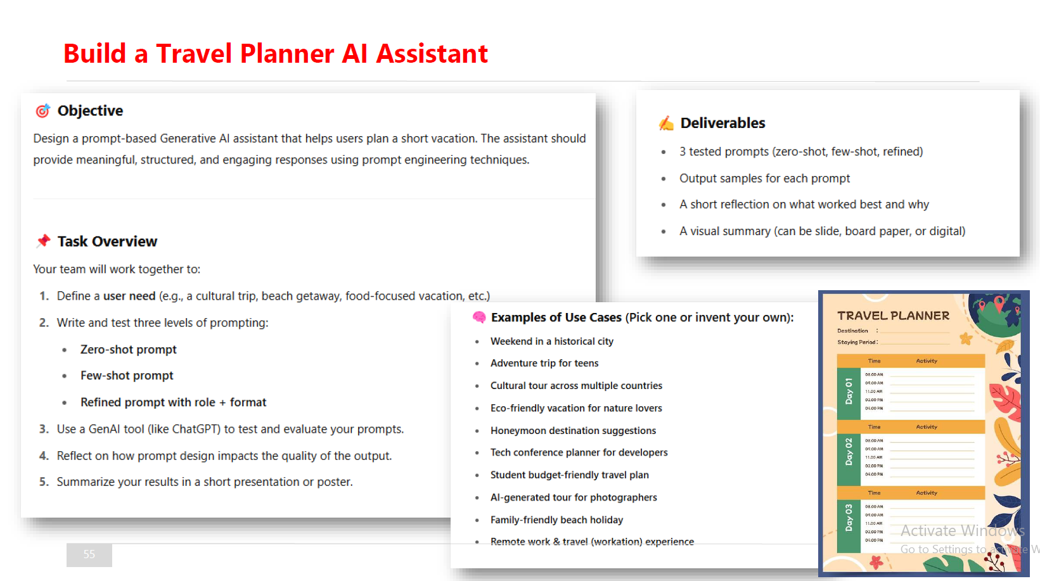
Courses

Slide 38
AI Agents &
Workflow Automation
Presented by : Omar Abdallah
www.linkedin.com/in/omar-abdallah-abdelrahman/

Slide 39
Working with
Gen-AI APIs

Slide 40
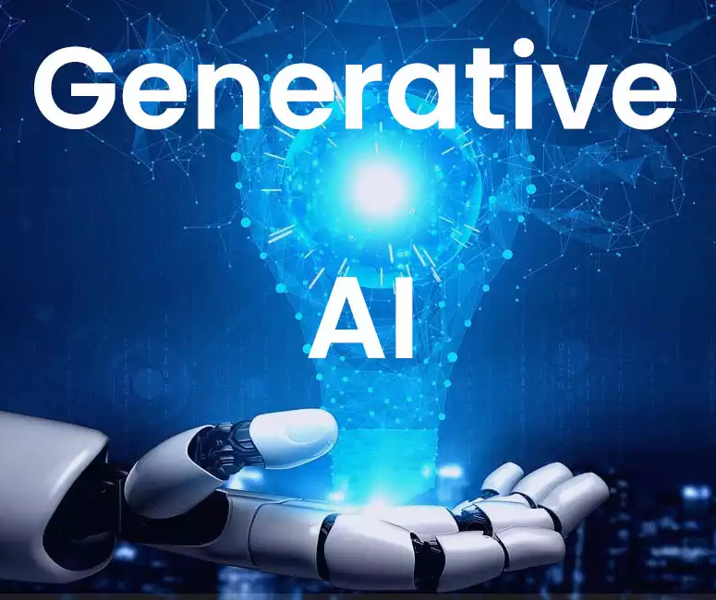
Working with Gen AI APIs (Vendors)
OpenAI Models
DeepSeek AO Models
Google AI Models
Anthropic AI Models
Qwen AI Models
MS Azure OpenAI Service
Hugging Face Platform
MS Azure AI Models
GitHub Models

Slide 41
Fine Tuning and RAG
1

Slide 42
Foundation Models and Fine-Tuning
What are Foundation Models?
Foundation models are large-scale AI models pre-trained on vast, diverse datasets. These models are designed to be highly generalizable, providing the base for a wide range of downstream tasks. Examples of foundation models include GPT-4, BERT, and CLIP. These models are versatile, capable of handling various data types such as text, images, and audio.
Fine-Tuning
Fine-tuning refers to the process of customizing a pre-trained foundation model for a specific task by training it on additional, domain-specific data. This approach allows organizations to adapt foundation models to their needs without the need for extensive retraining from scratch. For example, a general language model like GPT can be fine-tuned to better handle finance-related text, resulting in models like FinBERT.
Benefits of Fine-Tuning
Customization: Fine-tuning enhances the model’s performance for specific applications, making it more relevant for niche use cases.
Efficiency: It requires less computational power and data compared to training a model from scratch.
Scalability: Fine-tuned models can be deployed across various domains, from healthcare to finance and beyond.
2

Slide 43
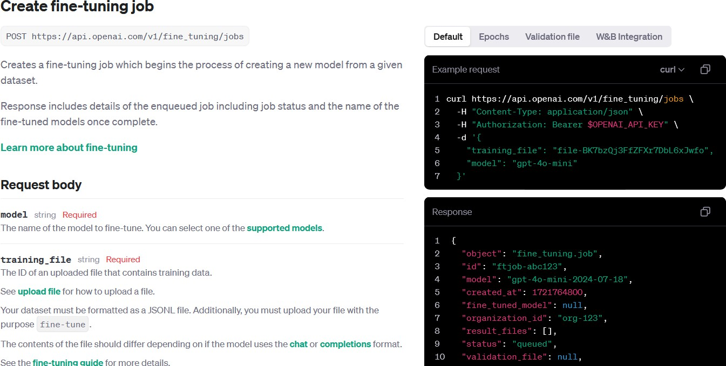
Fine-Tuning – Getting started
https://platform.openai.com/docs/api-reference/fine-tuning/create
3

Slide 44
Retrieval-Augmented Generation (RAG)
What is RAG?
Retrieval-Augmented Generation (RAG) enhances a language model's capabilities by allowing it to access external data sources in real-time. It works by retrieving relevant information from databases or other sources and combining it with the user's query to generate a more contextually accurate and up-to-date response. This is particularly useful when dealing with constantly evolving fields like healthcare or finance, where accessing the latest information is crucial.
RAG VS. Fine tuning
RAG differs from fine-tuning primarily in how each method handles information:
RAG dynamically retrieves external data from databases or APIs during inference, enabling the model to access and incorporate real-time, ensuring the generated responses are up-to-date. It doesn't alter the model's internal knowledge but enhances its answers with current, relevant data.
In contrast, fine-tuning involves retraining the model with a domain-specific dataset to embed specialized knowledge directly into the model itself. This means fine-tuned models provide consistent, specialized outputs but lack the ability to adapt to new or updated information without retraining. This permanently embeds domain-specific knowledge within the model, making it more adept at particular tasks but unable to incorporate new information unless retrained
4

Slide 45
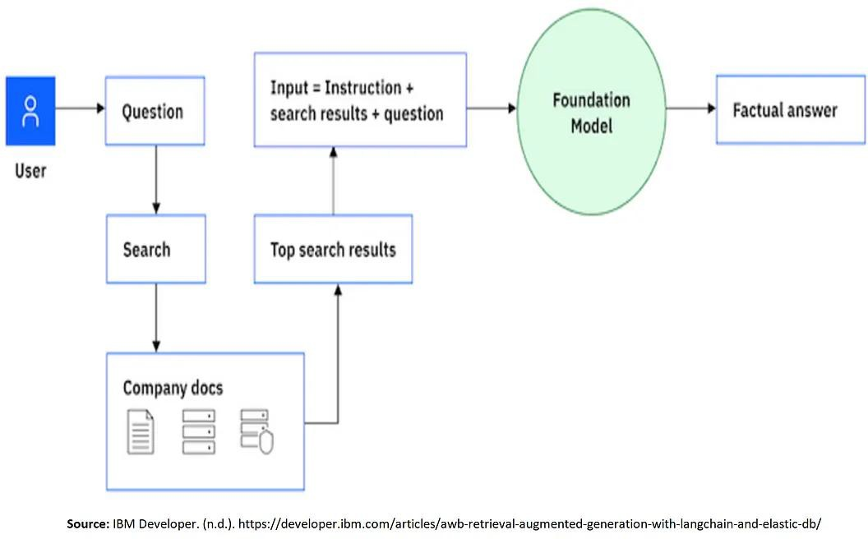
Retrieval-Augmented Generation (RAG) – Cont.
5

Slide 46
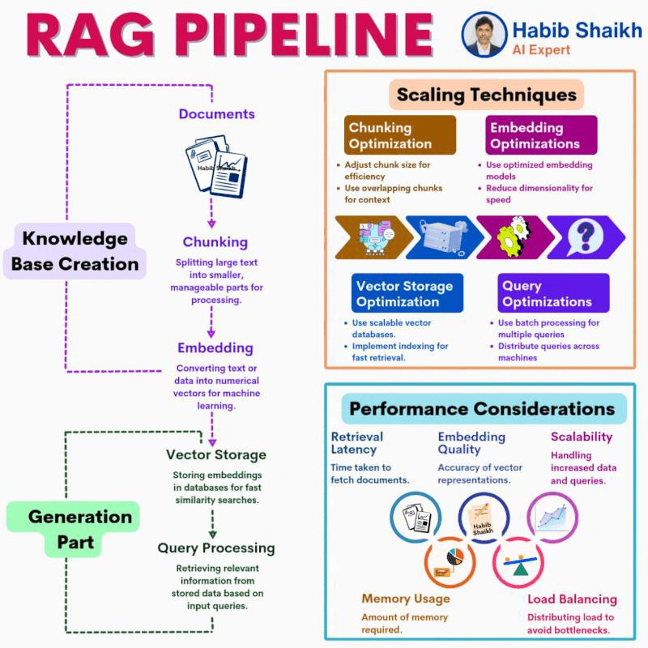
RAG data pipeline flow
High-level flow for a data pipeline that supplies grounding data for a RAG application:
Documents are either pushed or pulled into a data pipeline.
The data pipeline processes each document individually by completing the following steps:
  Chunk document: Breaks down the document into semantically relevant parts that ideally have a single idea or concept.
  Enrich chunks: Adds metadata fields that the pipeline creates based on the content in the chunks. The data pipeline categorizes the metadata into discrete fields, such as title, summary, and keywords.
  Embed chunks: Uses an embedding model to
vectorize the chunk and any other metadata fields that are used for vector searches.
  Persist chunks: Stores the chunks in the search index.
6
General

Slide 47
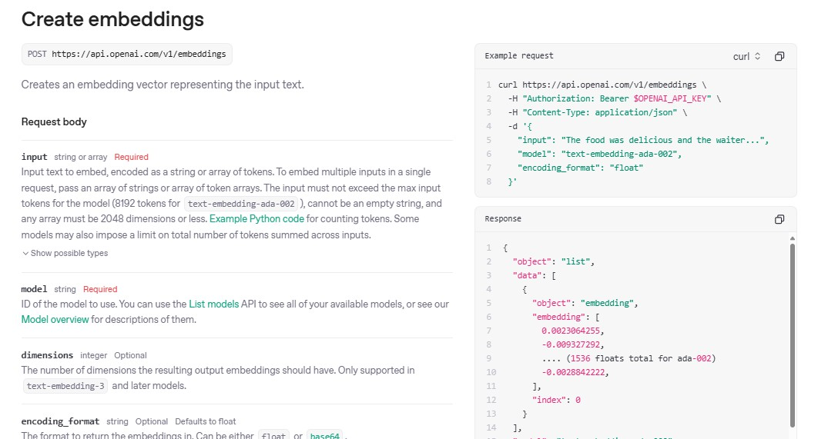
RAG – Creating Embeddings
9
API Reference - OpenAI API

Slide 48
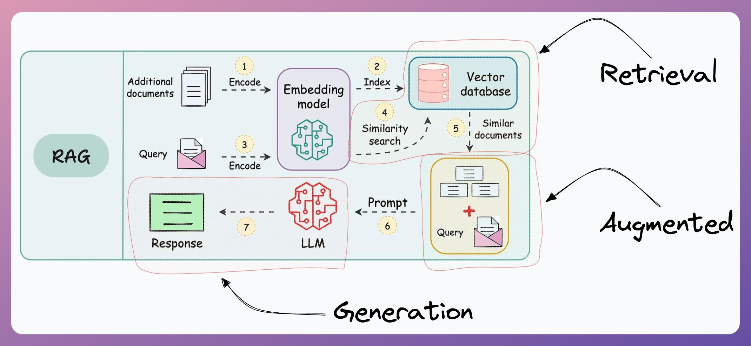
RAG re-represented
11

Slide 49
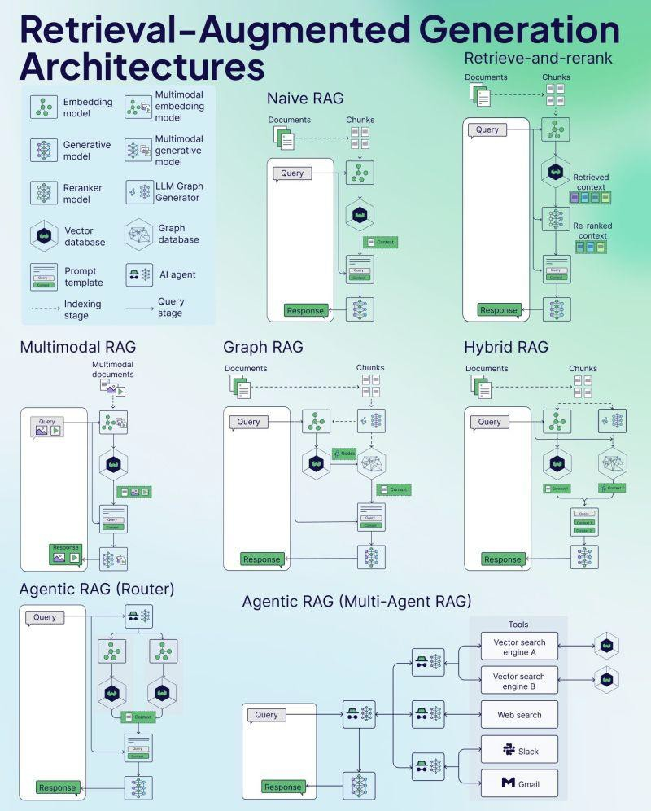
RAG Architectures
14

Slide 50
RAG Cycle VS Ordinary Cycle
Knowledge File
↓
Chunking
↓
Embeddings
↓
Vector Store
↓
Question
↓
Similarity Search
↓
Prompt (Combo)
↓
LLM
↓
Response
Prompt
↓
LLM
↓
Response

Slide 51
AI Agents
1

Slide 52
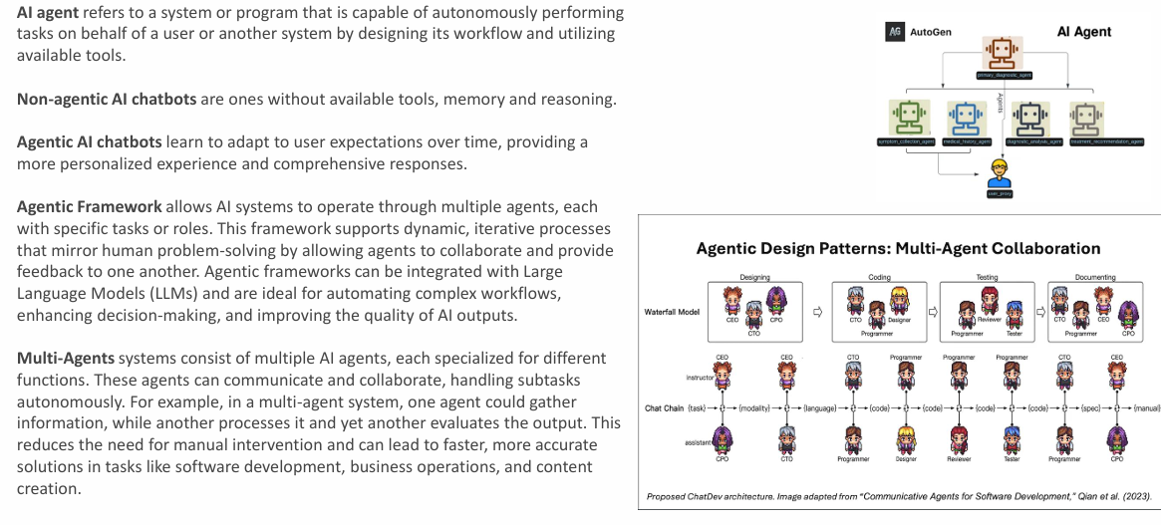
Agentic Framework and Multi-Agents

Slide 53
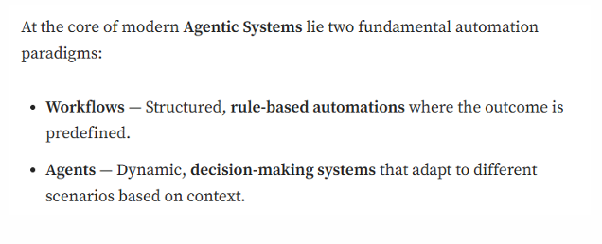
AI Workflows vs AI Agents

Slide 54
Key features of an AI agent
Reasoning: This core cognitive process involves using logic and available information to draw conclusions, make inferences, and solve problems. AI agents with strong reasoning capabilities can analyze data, identify patterns, and make informed decisions based on evidence and context.
Acting: The ability to take action or perform tasks based on decisions, plans, or external input is crucial for AI agents to interact with their environment and achieve goals. This can include physical actions in the case of embodied AI, or digital actions like sending messages, updating data, or triggering other processes.
Observing: Gathering information about the environment or situation through perception or sensing is essential for AI agents to understand their context and make informed decisions. This can involve various forms of perception, such as computer vision, natural language processing, or sensor data analysis.
Planning: Developing a strategic plan to achieve goals is a key aspect of intelligent behavior. AI agents with planning capabilities can identify the necessary steps, evaluate potential actions, and choose the best course of action based on available information and desired outcomes. This often involves anticipating future states and considering potential obstacles.
Collaborating: Working effectively with others, whether humans or other AI agents, to achieve a common goal is increasingly important in complex and dynamic environments. Collaboration requires communication, coordination, and the ability to understand and respect the perspectives of others.
Self-refining: The capacity for self-improvement and adaptation is a hallmark of advanced AI systems. AI agents with self-refining capabilities can learn from experience, adjust their behavior based on feedback, and continuously enhance their performance and capabilities over time. This can involve machine learning techniques, optimization algorithms, or other forms of self-modification.
https://cloud.google.com/discover/what-are-ai-agents

Slide 55
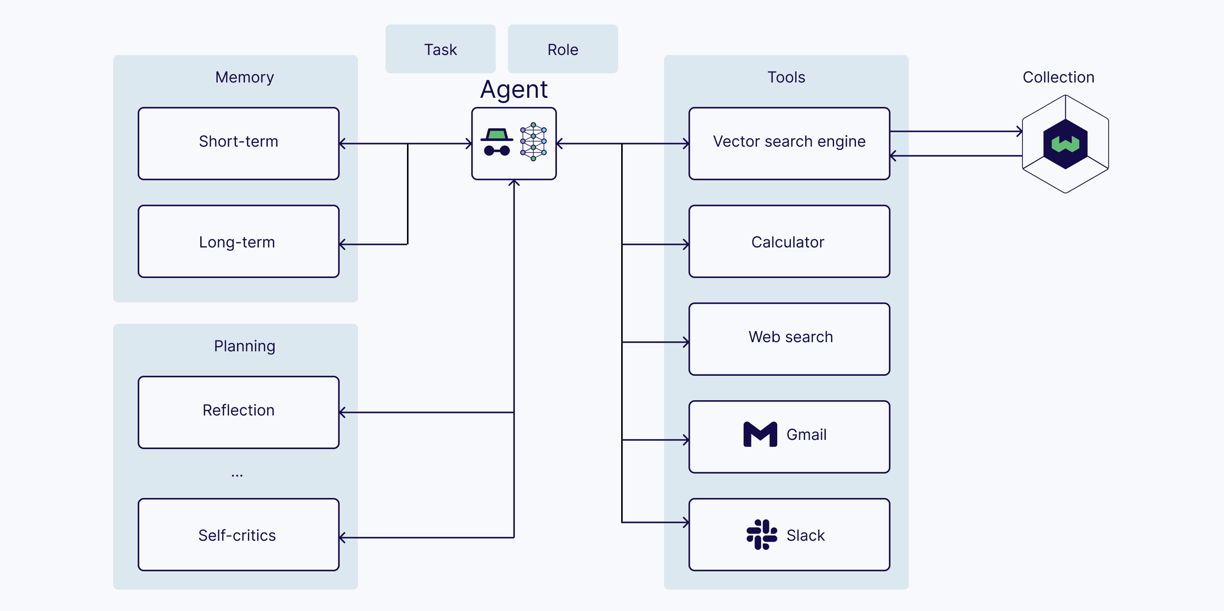
Core components of an AI agent
LLM (with a role and a task)
Memory (short-term and long-term)
Planning (e.g., reflection, self-critics, query routing, etc.)
Tools (e.g., calculator, web search, etc.)
12

Slide 56
N8N
59

Slide 57
Thank you
59

Slide 58
Lab
​
Task 1: Fine-Tuning vs. RAG ​
Prepare a report comparing Fine-Tuning and Retrieval-Augmented Generation (RAG). Your report should include: ​
A comparison of their concepts, advantages, limitations, and use cases. ​
A brief explanation of real-world scenarios where each approach is the most suitable choice. ​
​
Task 2: Workflows vs. AI Agents ​
Prepare a report explaining the key features and differences between AI Workflows and AI Agents. Include: ​
Core characteristics of each approach. ​
Their strengths, limitations, and common use cases. ​
Examples of real-world applications. ​
​
Task 3: RAG Research ​
Research the RAG pipeline and identify: ​
The most widely used chunking techniques for document processing. ​
The most popular vector databases used to store embeddings. ​
A brief overview of when and why each technique or database is commonly used. ​
Task 4: N8N Automation (Bonus) ​
​
​

